Slide 1

Level Up To Better Understand Your EIV REPORT and Most Common EIV Findings
North Tampa Housing Development Corporation
SAHMA – Florida Conference
Wednesday 4/24/2024
Notes:
Welcome

Slide 2
Session Speakers
Master File Reports
Dorothy Swayze
Local Services Manager
North Tampa Housing Development Corporation
  Contact Information:
  CGI Federal/NTHDC
  Phone: (813) 554-1264
  Email: dorothy.swayze@cgifederal.com
Tenant File Reports
Rebecca Kuntz
Local Services Manager
North Tampa Housing Development Corporation
  Contact Information:
  CGI Federal/NTHDC
  Phone: (813) 554-1271
  Email: Rebecca.Kuntz@cgifederal.com

Slide 3
HOTMA
  This session is based on the current EIV guidelines as they are still in effect until TRACS is updated and Software is updated. After software is updated to be fully compliant with TRACS, then new EIV procedures updated for HOTMA will be implemented. However be on the lookout for some HOTMA Easter Eggs that will pop up during this session to help you Level Up your future EIV game.
Easter Egg: Although cannot be implemented until after software is updated, when do EIV procedures need to be updated by for HOTMA?

Slide 4
EIV GAME
  Level 1 – Printing EIV Reports
  Level 2 – Reading and Interpreting EIV Reports
  Level 3 – Utilizing and Investigating EIV Reports
  Level 4 – Making the Necessary Corrections
  Level 5 – Notating Reports and Maintaining Documentation
Level 1
Level 2
Level 3
Level 4
Level 5

Slide 5
Level 1
Begin

Slide 6
Master File Reports
Tenant File Reports
Identity Verification
  Failed EIV Prescreening
  Failed Verification
Multiple Subsidy
Deceased Tenant
  New Hires
  Existing Tenant Search
  Summary
  Income
  Income Discrepancy
  What about the No Income Reported on the 50059 and No Income Reported by SSA and HHS Reports?
Must be run quarterly, but whether or not you print them and where you maintain them depends on what your EIV procedures say.

Slide 7
Level 1 – Printing EIV Reports
  When do you print:
Identity Verification Reports: Failed EIV Prescreening and Failed Verification
    Every month
Multiple Subsidy, Deceased Tenant, and New Hire Reports
      Depends on frequency outlined in your EIV procedures, but at least quarterly. More often if so outlined in your procedures (i.e. monthly if so stated).
Easter Egg: Be aware of how HOTMA will change when you use the New Hire Report

Slide 8
Level 1 – Printing EIV Reports
  When do you print:
  Existing Tenant Search
    For every member prior to MI
    Before each new member added after MI
  Summary
    Recertification (within 90 days after MI/IC if so stated in your procedures)
    Only needs to be printed once if everyone is listed as verified, but must continue to be printed at each recertification if not all statuses are listed as verified and continue to do so until they are
    Whenever there is a change in household composition
  Income and Discrepancy
    Within 90 days after MI/IC submission to TRACS, IR and AR
Easter Egg: Be aware of how HOTMA will change when you run Income and Discrepancy Reports (as updated in your pending revised EIV procedures)

Slide 9
Level 1 – Printing EIV Reports
Level 1 - Printing Reports
Complete
Now what?

Slide 10
Cheat Codes for Leveling up
Level 1
Knowledge is Power
Level 2
Level 2
Follow up is Key
Level 3
Level 3
Execution is Success
Level 4
Level 4
Documentation = Completion
Level 5

Slide 11
level up your understanding of EIV reports
  Level 1 – Printing EIV Reports
  Level 2 – Reading and Interpreting EIV Reports
  Level 3 – Utilizing and Investigating EIV Reports
  Level 4 – Making the Necessary Corrections
  Level 5 – Notating Reports and Maintaining Documentation
Level 1
Level 2
Level 3
Level 4
Level 5

Slide 12
Level 2
Level 3
Level 4
Level 5
BEGIN

Slide 13
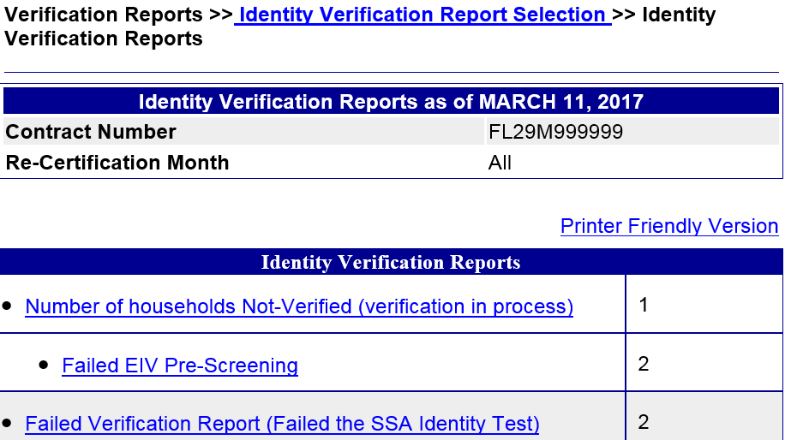
Identity Verification – Level 1
You have run the report, what now?
    Click on each report individually to view/print each report
    If 0 households are listed for one of the reports, print this screen as your monthly report

Slide 14
Failed EIV Pre-Screening Report – Level 2
Failed EIV Pre-Screening Report
Identifies household members with invalid or missing SSN, Last Name, or Date of Birth in TRACS
EIV will not have any income data for household members listed on the Failed EIV Prescreening Report
HUD Handbook 4350.3 Chapter 9, Exhibit 9-1 lists possible error codes and corrective actions for this report
HUD Handbook 4350.3 Chapter 9, 9-12 C. provides guidance on how to use this report

Slide 15
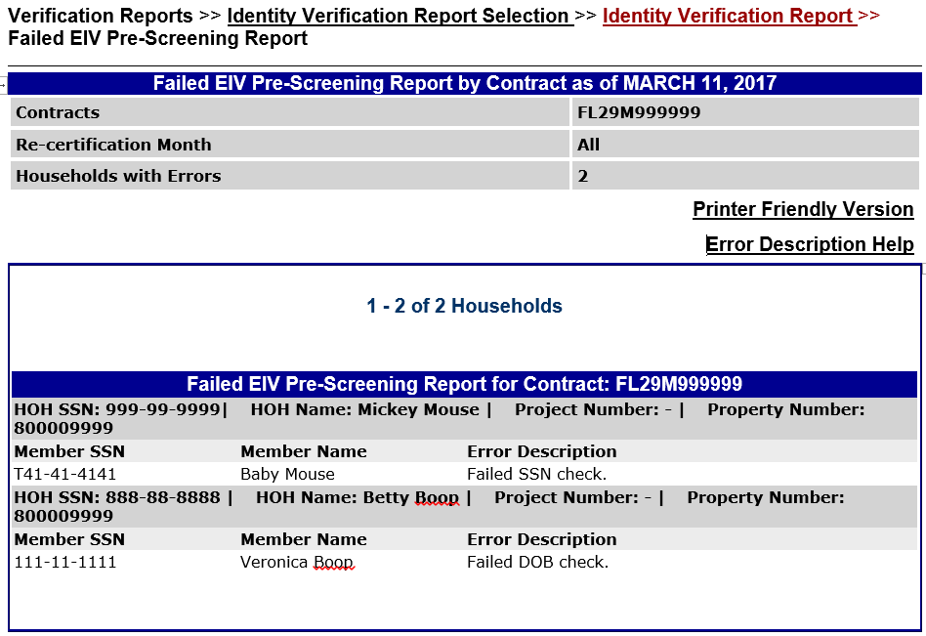
Failed EIV Pre-Screening Report – level 2
Important information to review:
HOH Name
Member with Error
Error Description
Why would the SSN have a T in it?
Member does not have a SSN yet and all 9s were entered on the 50059, TRACS then generates a T number.

Slide 16
Failed EIV Pre-Screening Report – Level 3, 4, & 5
If a tenant is listed on Failed EIV Pre-Screening:
    Within 30 days resolve the issue
      Check information in tenant file against data on the 50059
      If necessary, follow up with the tenant to confirm the personal identifier listed as incorrect on the report and obtain additional documentation of the correct information
      Correct all 50059 data that was incorrect and submit the corrected 50059 to TRACS
    Notate on the report for each tenant listed as to the action taken or reason for tenant being on the report
    Maintain documentation of all follow up actions taken including file notes, contact with tenant, and corrected 50059

Slide 17
Maintaining - Level 5
POWER BOOST
Where do you maintain reports and documentation?
      Report with notations of follow up action taken in the Master File for 3 years from date of report
      Corrected 50059s and other documentation of follow up in the Tenant File for term of tenancy plus 3 years

Slide 18
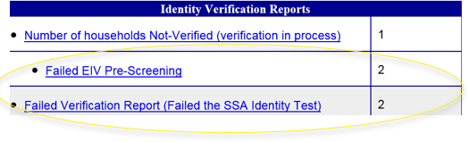
Failed Verification Report – Level 2
Failed Verification Report
Identifies household members with SSN, Last Name, or Date of Birth not matching info reported by SSA
EIV will not have any income data for household members listed on the Failed Verification Report
HUD Handbook 4350.3 Chapter 9, Exhibit 9-2 lists possible error codes and corrective actions for this report
HUD Handbook 4350.3 Chapter 9, 9-12 C. provides guidance on how to use this report

Slide 19
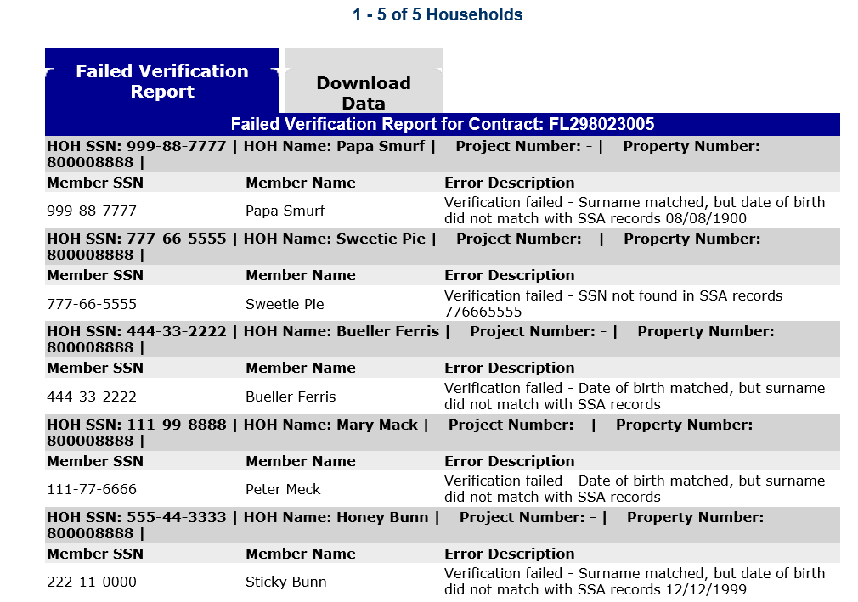
Failed Verification Report – Level 2
Important information to review:
HOH Name
Member with Error
Error Description

Slide 20
Failed Verification Report – level 2
Who is the HOH, Who is the member, and What is the reason for the error?

Slide 21
Failed Verification Report – Level 3, 4, & 5
If a tenant is listed on Failed Verification Report:
Within 30 days resolve the issue
  Check information in tenant file against data on the 50059
    If necessary, follow up with the tenant to confirm the personal identifier listed as incorrect on the report and obtain additional documentation of the correct information
    Correct all 50059 data that was incorrectly entered and submit the corrected 50059 to TRACS
    Encourage tenant to contact SSA to correct incorrect data from SSA
    Notate on the report for each tenant listed as to the action taken or reason for tenant being on the report
    Maintain documentation of all follow up actions taken including file notes, contact with tenant, and corrected 50059

Slide 22
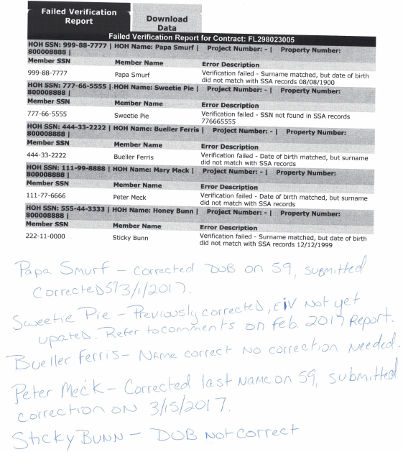
Notations - Level 5
POWER BOOST
Are these notations acceptable?
Why or Why Not?
Papa Smurf – OK
Sweetie Pie – Previously corrected, EIV not yet updated refer to notes on March report.
Bueller Ferris – Name correct no correction needed.
Peter Meck – Corrected last name on 59, submitted on May voucher
Stick Bunn – DOB not correct.

Slide 23
New Hires Report – Level 2
New Hires Report
Identifies tenants who have started a job in the last 6 months
MUST generate this report at least quarterly (or more frequently as outlined in the Owner/Agent’s EIV procedures)
    HUD Handbook 4350.3 Chapter 9, 9-11 D. 1. c. provides guidance on how to use this report
Easter Egg: Be aware of how HOTMA will change when you use the New Hire Report

Slide 24
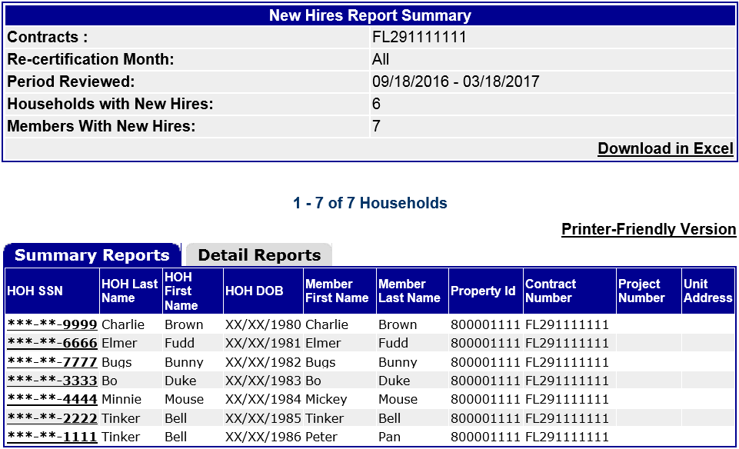
New Hires Report – Level 1
You have run the report, what now?
Print the screen with summary report tab for master file
    If 0 households listed on the New Hires Report, print the 0 results screen as your report to place in the master file

Slide 25
New Hires Report – Level 2
    The Detail Report tab will provide the details of the new employment for each listed person (hire date, name of employer), but does not provide page breaks for each of the listed tenants
Good for working the report

Slide 26
New Hires Report – Level 2
    Since the Detail Report tab does not provide page breaks for each of the listed tenants, it is not ideal for placing in tenant files; You will have to redact other tenant information
    A better option is to click on each name individually on the Summary Report to get individual Detail Reports to be printed for the tenant files and maintained along with all follow up documentation (notices, verifications, corrected 50059s etc.)

Slide 27
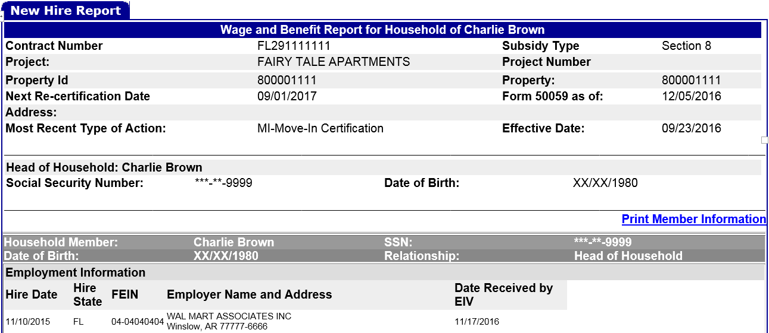
New Hires Report Level 1 and 2
    Summary report
    For master file
    Detail Report
    For tenant file

Slide 28
New Hires Report Level 2
Important Information:
HOH
Member on new hires report
Hire date
Employer
Last Certification

Slide 29
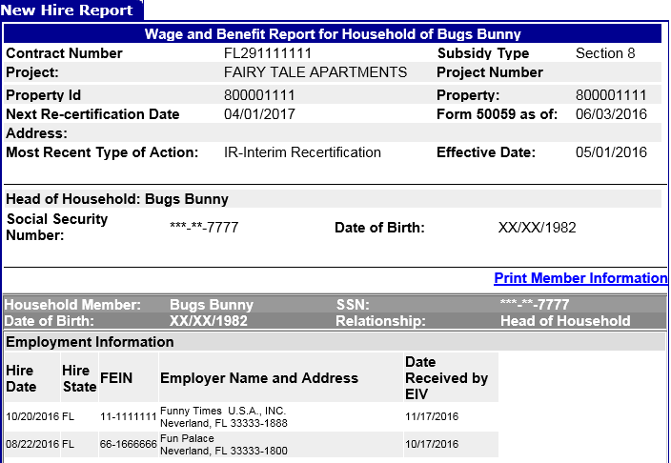
New Hires Report – Level 2

Slide 30
New Hires Report – level 3
If a tenant is listed on the New Hires Report:
Within 30 days resolve the issue
Review the detail report and tenant file to determine if tenant has already reported the change and the necessary recertifications processed
    If tenant has already reported the income and necessary recertifications/corrections processed, then notate the report accordingly
  If tenant has not already reported the income, then a follow up/investigation must be completed
  Contact the tenant with written notice and give them 10 days to report to the office discuss
  See HUD Handbook 4350.3 Chapter 7, Exhibit 7-7 for a sample letter

Slide 31
New Hires Report – level 3 & 4
  If tenant does not respond within 10 calendar days:
Assistance must be terminated effective the first rent period following the 10-day notice period (See sample notice provided in HUD Handbook 4350.3 Exhibit 7-8)
If the tenant subsequently submits the required information, the owner must reduce the tenant’s rent on the first of the following month based on verifications of income obtained
  If tenant responds and confirms the information is correct:
    Obtain verification and if income increased by more than $200 a month, process an IR 50059 and/or make corrections to affected certifications retroactive to 1st of the month following the hire date for unreported income
    Tenant must payback any overpayment in assistance resulting from unreported income
      Allow tenant to enter into a repayment agreement if needed
Easter Egg: Be aware of how HOTMA will change when an IR is required.

Slide 32
New Hires Report – Level 3 and 4
  If tenant responds and disputes the information in EIV:
    Document the information obtained from the tenant
    Obtain 3rd party verification from employer
    If tenant does have unreported income that is an increase of more than $200 a month:
    process an IR 50059 and/or make corrections to affected certifications with effective dates retroactive to 1st of the month following the hire date
    Tenant must payback any overpayment in assistance resulting from unreported income
      Allow tenant to enter into a repayment agreement
Easter Egg: Be aware of how HOTMA will change when an IR is required.

Slide 33
Follow Up Level 3
POWER BOOST
  What if the tenant responds and says I was working, but I am not anymore?
  Still need to investigate and verify start and end dates and wage amount. Retroactive IR may still be required.
Easter Egg: Be aware of how HOTMA will change when an IR is required.

Slide 34
New Hires Report – level 5
Notate on the New Hires Summary Report for each tenant listed as to the action taken or reason for tenant being on the report
Maintain documentation of all follow up actions taken including file notes, notices and other contact with tenant, verifications, IR 50059 and/or corrected 50059s, repayment agreement, new hire detail report etc.

Slide 35
Multiple Subsidy Report – Level 2
Multiple Subsidy Report
Identifies tenants who may be receiving assistance at another property
MUST generate this report at least quarterly (or more frequently as outlined in the Owner/Agent’s EIV procedures)
HUD Handbook 4350.3 Chapter 9, 9-12 B. provides guidance on how to use this report

Slide 36
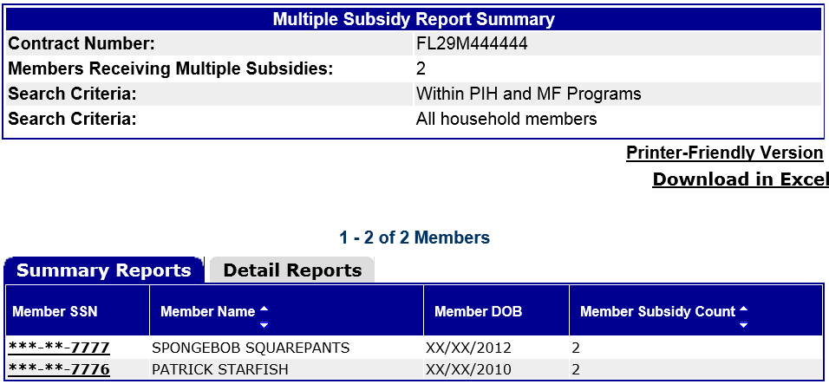
Multiple Subsidy Report – Level 1
You have run the report, what now?
Print the screen with summary report tab for master file
    If 0 households listed, print the 0 results screen as your report to place in the master file

Slide 37
Multiple Subsidy Report – Level 2
You have run the report, what now?
    The Detail Report tab will provide the details of the member and where the member may be receiving subsidy, but does not print with page breaks between listed members
Good for working the report

Slide 38
Multiple Subsidy Report – Level 1 and 2
    Since the Detail Report tab does not provide page breaks between listed tenants, it is not ideal for placing in tenant files; You will have to redact other tenant information
    Clicking on each name individually on the Summary Report will bring up individual Detail Reports, but it is important to note while it will bring up the information about where the member is receiving subsidy it does not list the member when done this way
    Print a Detail Report for the tenant file to be maintained along with all follow up documentation (notices, verifications corrected 50059s etc.)

Slide 39
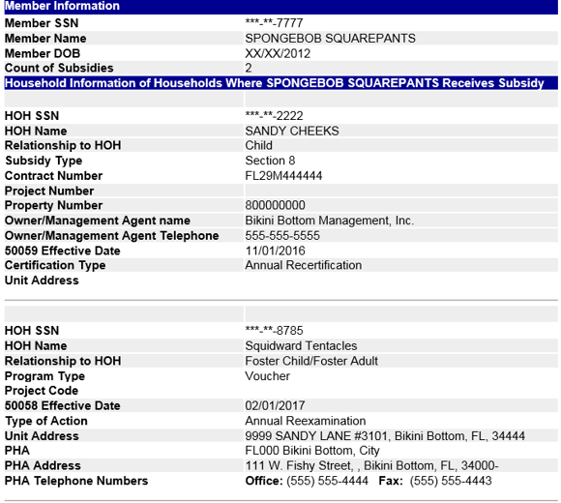
Multiple Subsidy Report – Level 1 and 2
    Summary report
    For master file
    Detail Report
    For tenant file

Slide 40
Multiple Subsidy Report – Level 2
Important Information:
Member receiving double subsidy
HOH and relationship to the member receiving double subsidy
Property information where the member is receiving subsidy elsewhere
The HOH the member is listed as living with at other property and relationship
Effective date of certification at other property and property type

Slide 41
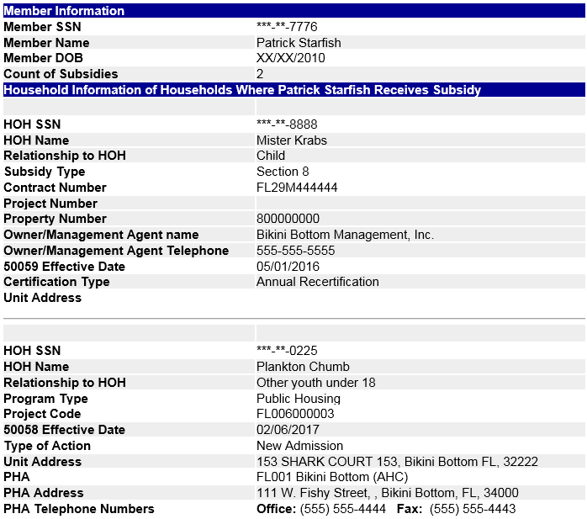
Multiple Subsidy Report – Level 2

Slide 42
Multiple Subsidy Report – level 3, 4, & 5
If a tenant is listed on the Multiple Subsidy Report:
Within 30 days resolve the issue
Discuss the result with the tenant
Contact the manager at the other property to verify whether or not the tenant/member is receiving assistance there
Owner/Agent at both properties must determine at which property subsidy should be terminated
In cases of joint custody of a child, it must be determined who will receive the dependent deduction because only one household can receive it
Process termination of subsidy or corrections as needed
Notate on the Multiple Subsidy Summary Report for each tenant listed as to the action taken or reason for tenant being on the report
Maintain documentation of all follow up actions taken including file notes, contact with tenant and other property, termination of assistance or corrections (if applicable), detail report etc.

Slide 43
Follow up and Correction– Level 3 and 4
POWER BOOST
If a tenant has custody of a child 50% of the time and they are on the multiple subsidy report, what needs to happen?
If both parents are living in assisted housing and listing the child on the 50059 because of 50/50 custody, only 1 of them can receive the dependent deduction. You must contact the other property and confirm if other parent living there is receiving the deduction or not….if both receiving the tenants must determine which parent will receive the deduction and the correct 50059 special codes must be used.

Slide 44
Deceased Tenant Report – level 2
Deceased Tenant Report
Identifies tenants who may be deceased at your property (reported as deceased by SSA)
MUST generate this report at least quarterly (or more frequently as outlined in the Owner/Agent’s EIV procedures)
HUD Handbook 4350.3 Chapter 9, 9-12 D. provides guidance on how to use this report

Slide 45
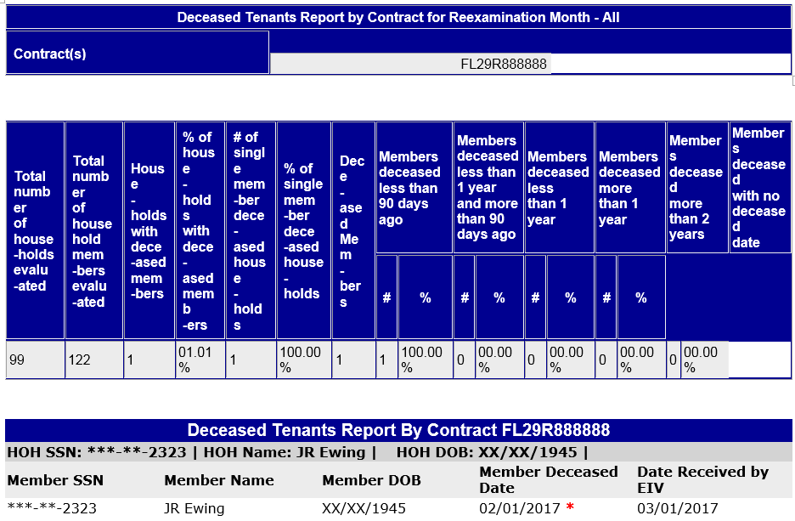
Deceased Tenant Report – Level 1 and 2
You have run the report, what now?
Print the report for the master file even if 0 households listed
Important information:
HOH
Member
Date deceased
POWER BOOST Level 2 - What does the red star mean next to date?
Death of sole member

Slide 46
Deceased Tenant Report – Level 3, 4, and 5
If a tenant is listed on the Deceased Tenant Report:
Within 30 days resolve the issue
Confirm in writing the member is deceased with the HOH, next of kin, emergency contact etc.
    If member is deceased, process a:
      MO 50059-A for sole household member
      IR 50059 to remove the deceased member
    If member is not deceased:
    Correct any incorrect data in TRACS
    Encourage tenant to contact SSA to correct incorrect data in SSA system
Notate on the Report for each tenant listed as to the action taken or reason for tenant being on the report
Maintain documentation of all follow up actions taken including file notes, contact with HOH, next of kin emergency contact, etc.. and IR or MO 50059-A

Slide 47
Deceased Tenant Report – Level 4
Bonus Round
      When processing a MO 50059-A for sole household member
      List the correct MO reason code on the 50059-A
      List the correct date of death on the 50059-A
      List the actual date of MO as the effective date on the 50059-A
      Why is this important?
        Subsidy paid for up to 14 days after the date of death only
        Actual MO date may be longer than 14 days after move out, but the correct voucher adjustment to stop subsidy after the 14th day will be made when the correct reason code and the correct date of death is listed on the 50059-A

Slide 48
No Income Reported on 50059 Report and
No income Reported by HHS or SSA Report
No Income Reported on 50059 and No Income reported by HHS or SSA Reports
The No Income Reported on 50059 report will identify tenants with no reported income on the 50059
The No Income Reported by HHS or SSA report will identify tenants with no reported income in EIV (wages, SS, SSI or unemployment)
HUD Recommends Owner/Agents have a policy to re-verify the status of tenants reporting zero income at least quarterly

Slide 49
No Income Reported on 50059 Report and
No income Reported by HHS or SSA Report
Owner/Agents must use these report only as identified and described in their policies and procedures – not required to be printed unless specified you will do so in your procedures
As part of procedures for using this report, Owner/ Agent must include using Income Report to determine if there is income
HUD Handbook 4350.3 Chapter 9, 9-11 D. 1. a. and b. provides guidance on how to use these reports
These reports can either be master file reports or tenant file reports depending on how you have outlined in your procedures how you will use these 2 reports

Slide 50
Common findings – EIV Master File Reports
Top Findings:
Not printing and maintaining each report in a Master file consistently when required as outlined in the property’s EIV procedures(even when 0 results found)
Not notating the report or not notating the report with sufficient comments regarding follow up actions for each tenant listed on each master file report
Not following up/investigating the issue for each tenant listed on each report (or not doing so within 30 days)
Not maintaining documentation of all follow up actions in the tenant files and/or maintaining the detail reports in the master file
Not making the necessary corrections and/or correct voucher adjustments

Slide 51
Existing Tenant Search – Level 1 and 2
Existing Tenant Search
MUST generate this report prior to move-in, one report for each household member including dependents; and for each member added to the household after MI
System searches for a match based on SSN in both Public Housing and Multifamily Properties
Identifies household members that are currently receiving subsidy to help avoid Double Subsidy problems
Use of the report must be included in the Tenant Selection Plan
HUD Handbook 4350.3 Chapter 9, 9-12 A. provides guidance on how to use this report
POWER BOOST Level 1 - Does the existing tenant search need to be run on a newborn added after MI?
YES

Slide 52
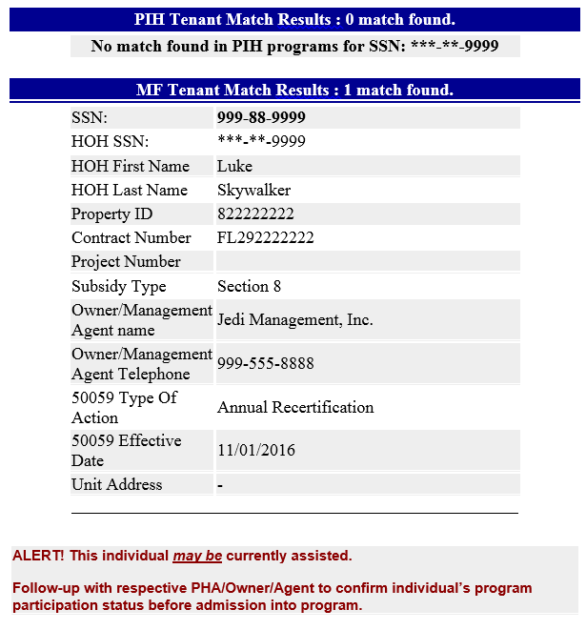
Existing Tenant Search – Level 2
You have run the report, what now?
Print the report for each household member for the tenant file even if no matches found
Important information:
HOH at other property the member is currently receiving subsidy
Property and O/A information where the member is receiving subsidy
Last certification type and effective date

Slide 53
Existing Tenant Search – Level 3, 4, and 5
If there is a household member that is listed as being an existing tenant:
Discuss the result(s) with applicant
Contact the manager at the other property to verify applicant is a tenant there
Coordinate the move-out / move-in dates to avoid double subsidy problems
Notate report(s) with comments regarding discussions with tenant and/or manager from other property and coordination plans
Maintain the reports in the tenant file for term of tenancy plus 3 years, or if applicant does not MI then with the application for 3 years from the date of the report

Slide 54
Summary, Income, & Discrepancy Reports – Level 1
  Summary, Income, & Discrepancy Reports
  All 3 reports are automatically generated each time the Income Report is run in EIV
  System searches for available personal identifiers and income data for each member and matches that data to information listed on the last 50059 submitted to TRACS
  Must generate these reports within 90 days after MI or IC 50059 submission , and each AR & IR (and other times if so outlined in O/A procedures)
  Must maintain the reports in the tenant files
  HUD Handbook 4350.3 Chapter 9, 9-11 A, B, and C. provides guidance on how to use these reports
Easter Egg: Be aware of how HOTMA will change when you run and how to use these reports.

Slide 55
Summary Report – Level 2
Summary Report
Lists all members of the household with their personal identifiers and Identity Verification Status
Status will be either:
Verified – info on 50059 matches SSA
Failed – member info does not match
Not Verified – member 50059 info has not been sent to EIV
Deceased – member reported by SSA as deceased
EIV will only have income info for tenants whose status is Verified
Notes:
Personal identifiers are last name, DOB and SSN

Slide 56
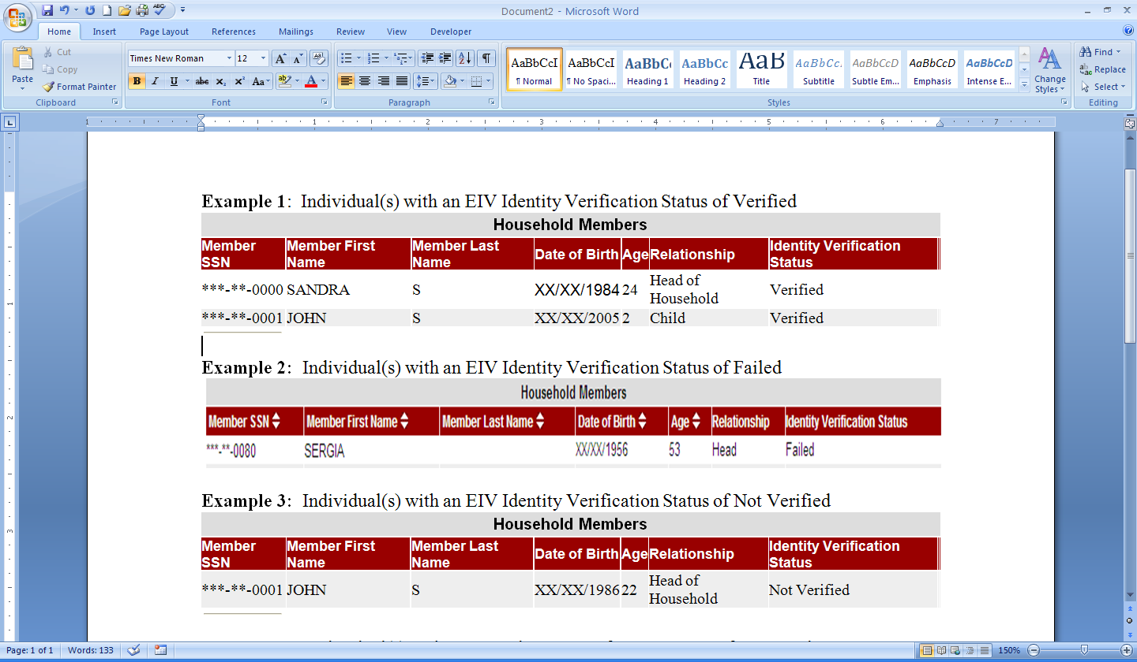
Summary Report – Level 2
You have run the reports, what now?
Notes:
Ex 2: Means either last name, DOB or SSN doesn’t match SSA database and further investigation is need.
EXAMPLE 3: Owners do not have to do anything at the time of recertification when the status is “Not Verified”. However, the owner must check the Failed SSA Identity Test report monthly as changes in the Identity Verification Status for these tenants may occur.

Slide 57
Summary Report – Level 1 and 2
Must review the Summary Report each time the Income Report is generated
Must print and retain the Summary Report in tenant file for term of tenancy and 3 years after move-out
  If all members have a status of “Verified” the report does not have to be printed again unless there is a change in family composition or the listed status of a member changes
  Must continue to print and maintain in the tenant file all Summary Reports that do not list all members as “Verified”

Slide 58
Summary Report – Level 3, 4, and 5
Resolve any Failed or Deceased status for any member within 30 days of running the report
  Correct 50059 data entry errors and resubmit the 50059
  Encourage tenant to contact SSA to correct incorrect data from SSA
    call or visit local office
Maintain file notes and documentation of all follow up action taken to resolve the Failed or Deceased status
  Includes maintaining documentation of verified exemption for any member of the household that is exempt from providing a SSN
Notes:
Exempt from SSN disclosure and verification requirements: Tenants who were 62 years of age or older as of January 31, 2010, and whose initial determination of eligibility was begun before January 31, 2010, and Individuals who do not contend eligible immigration status. These individuals will continue to have a TRACS generated identification number in the SSN field. No employment or income
information will be provided in EIV for these individuals, therefore, third party verification from income source will have to be obtained.

Slide 59
Income Report – Level 2
Income Report
Income Report includes information for each household member for:
    Wages
      Including New Hire Information
    Unemployment benefits
    Social Security benefits
      SS, SSI, Dual Entitlements, and Medicare
  Income report does not include income from other sources:
Child Support
Welfare
Family Contributions
Pensions
Income from Assets

Slide 60
Income Report Wages – Level 2 and 3
Wages
Information is updated quarterly - approximately 1 to 2 months after the end of the calendar quarter
Income Report is 3rd party verification that tenant is employed
Must obtain 4 consecutive, recent paystubs from tenant to calculate income
  Wage information in EIV cannot be used to calculate income
Easter Egg: Be aware of how HOTMA will change how to use and verify the wage income from EIV

Slide 61
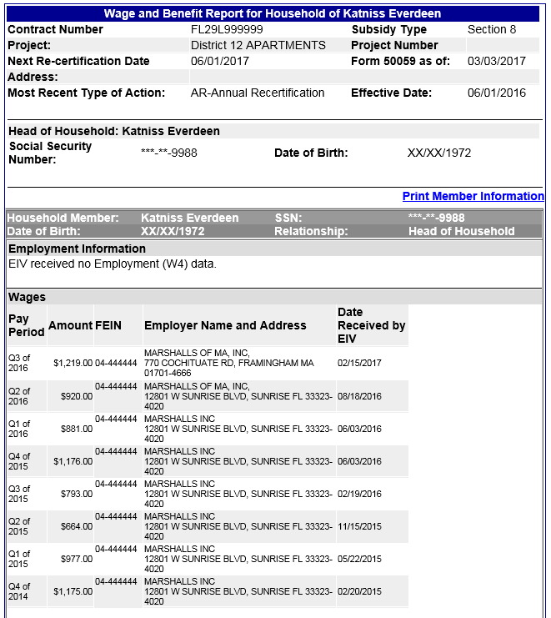
Income Report Wages – Level 2, 3, 4, and 5
You have run the report, what now?
Review the report
Compare report wage information to what was reported by the tenant
Compare past wage information on the report to wage information on past 50059s and the file
Notify and speak with tenant
Obtain any needed verifications
Process any corrections and/or retroactive IRs
Process pending recertification
Process any necessary repayment agreements
Maintain all documentation
Easter Egg: Be aware of how HOTMA will change when an IR is required and verifications needed.

Slide 62
Income Report Wages – Level 2
Important Information:
Last certification type and effective date listed in TRACS
Member with wages and relationship to the HOH
New Hire Information
Wages paid for the last 8 quarters

Slide 63
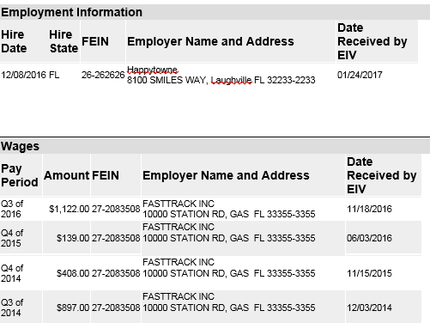
Income Report Wages – Level 2
What is this income report telling you?
Notes:
Fasttrack also appears to be kinda sporadic. It appears this tenant was working at FastTrack and is now appearing on the new hire report for Happytowne. If the tenant has not come and reported this you will need to contact the tenant. They might have quit working at Fasttrack or they might still be working there and also now working at Happytowne.

Slide 64
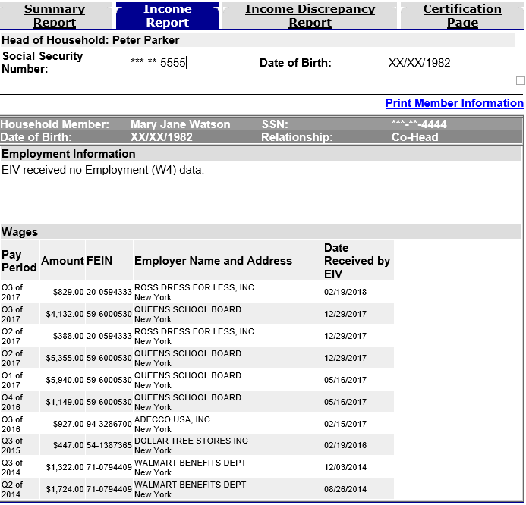
Income Report Wages – Level 2
What is this income report telling you?
Why would this report not show a new hire even though the quarterly wages seem to show a new job?
Notes:
Household member receiving wages is Mary Jane Watson. So it appears Mary Jane has now started working at Ross Dress for Less showing as income from wages in Q2 but its not showing as a new hire? Why is that? Might have been more than 6 months since the tenant started this job at Ross and New Hires usually fall off after a certain time. Doesn’t look like she stopped working at Queens but added Ross Dress. Looks like 2nd job. Havent rerpoted Roos then something you would need to follow up on appears to be more than $200 month.

Slide 65
Income Report Wages– Level 3 and 5
Obtain traditional 3rd party verification of employment if:
Tenant insists they are not employed, but wage information is listed in EIV
Tenant reports recently gaining or losing a job
Tenant reports they are working but no wage information is in EIV
Tenant is unable to provide the required paystubs
  Do not wait for the tenant to accumulate 4 check stubs before processing the IR
Easter Egg: Be aware of how HOTMA will change the order and acceptability of verifications

Slide 66
Income Report Unemployment– Level 2
Unemployment Benefits
Information is updated quarterly - approximately 1 - 2 months after the end of the calendar quarter
EIV serves as 3rd party verification that tenant is receiving unemployment benefits
Must obtain 4 consecutive benefit “paystubs” or benefit letter from tenant to calculate income
  Information in EIV cannot be used to calculate income
Easter Egg: Be aware of how HOTMA will change the order and acceptability of verifications

Slide 67
Important Tidbits to Remember
  During COVID there were some supplemental
  unemployment payments that were considered income and some that were to be excluded from income.
  Where can this guidance be found?
  Questions and Answers for Office of Multifamily Housing stakeholders Coronavirus Disease 2019
  What Unemployment payment was counted and what was not counted?
  Regular Unemployment payments IS counted.
  Pandemic Unemployment Assistance (PUA) IS counted
  Federal Pandemic Unemployment Compensation (FPUC) IS NOT counted
  Pandemic Emergency Unemployment Compensation (PEUC) IS counted
  What timeframe is affected:
  2020 through end of 2021

Slide 68
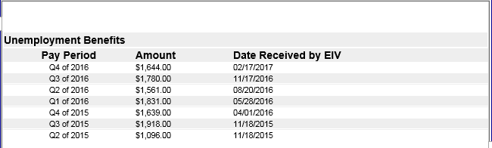
Income Report – Unemployment – Level 2, 3, 4, and 5
Review the report
Compare report Unemployment information to what was reported by the tenant
Compare past unemployment information to wage information on past 50059s
Obtain any needed verifications
Process any corrections and/or retroactive IRs
Process pending recertification
Process any necessary repayment agreements
Maintain all documentation

Slide 69
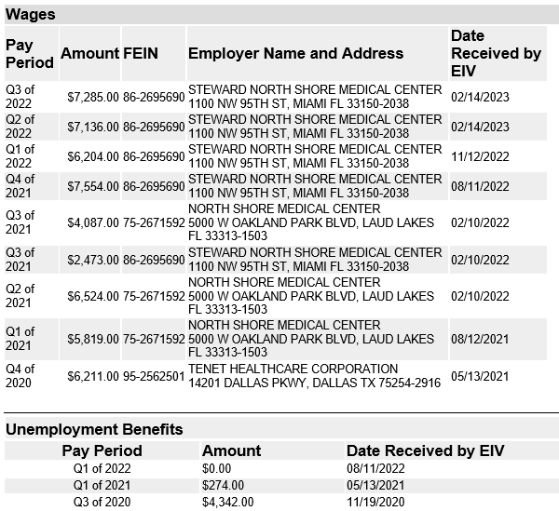
Income Report – Unemployment – Level 2
What is this income report telling you?
What do we need to lookout for with this unemployment?
Notes:
Tenant had unemployment benefits and appears they have stopped since tenant is working again. Pay attention to the unemployment for Q3 2020 as this corresponds with the COVID rules on the previous slide and some of this unemployment may or may not be counted as income.

Slide 70
Income Report Unemployment– Level 3 and 5
Obtain traditional 3rd party verification of Unemployment Benefits if:
Tenant insists they are not receiving unemployment, but benefit information is listed in EIV
Tenant reports they are receiving unemployment, but no benefit information is in EIV
Tenant is unable to provide documentation
Easter Egg: Be aware of how HOTMA will change the order and acceptability of verifications

Slide 71
Income Report Social Security Benefits – Level 2 & 3
Social Security Benefits
Information is updated quarterly - approximately 1 to 2 months after the end of the calendar quarter
EIV serves as third party verification and can be used to calculate annual income from SSA benefits as long as the tenant agrees with the information
SSA COLA is not available in EIV until the end of the calendar year
Notes:
If the tenant agrees with the social security benefit information on the EIV Income Report, the owner must use the EIV Income Report as third party verification, receiving social security benefits and also for calculating the tenant's annual income.

Slide 72
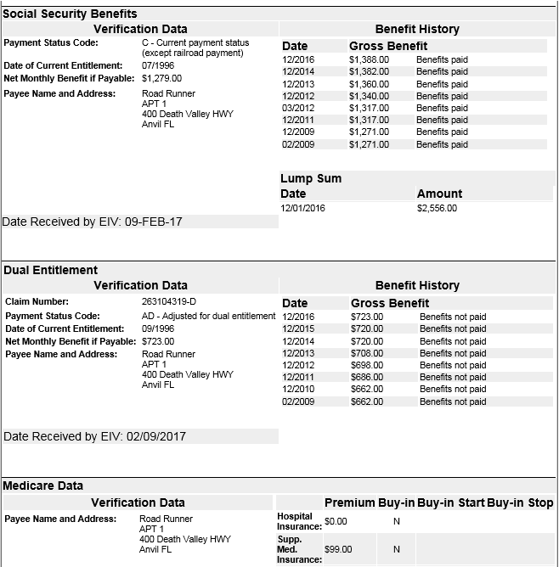
Income Report Social Security – Level 2, 3, 4, and 5
Review the report
Compare report SS and SSI information to what was reported by the tenant
Compare past SS and SSI information to information on past 50059s
Obtain any needed verifications
Process any corrections and/or retroactive IRs
Process any necessary repayment agreements
Process pending recertification
Maintain all documentation
Notes:
Dual entitlement means benefits paid to an individual on behalf of a deceased individual that earned the benefit.

Slide 73
Income Report Social Security – Level 2
Important Information:
Gross and net amounts currently being received
Benefit type
Medicare Information
Based on the available information in EIV, is there enough information to calculate income and deductions from Medicare?

Slide 74
Income Report – Social Security – Level 2
Gross Benefit $1388
Net Benefit $1279
$1388-$1279 = $109
Medicare $99
Unaccounted difference of $10
What, if anything needs to be done?
Verify what the $10 difference is for. And how to account for it. It could be an RX plan payment being deducted or an overpayment in benefits being deducted, or child support garnishment.

Slide 75
Income Report Social Security – Level 3 and 5
Obtain traditional 3rd party verification of SSA Benefits if:
Tenant disagrees with information in EIV
The difference between the gross benefit and the net benefit cannot be explained by Medicare amount that is listed in EIV
EIV will not have information on Medicare Part D (prescription drug plan)
If tenant reports paying for Part D, additional verification is required
Tenant may have garnishments or amounts for an overpayment being withheld
Easter Egg: Be aware of how HOTMA will change the order and acceptability of verifications

Slide 76
Income Discrepancy Report – Level 1 and 2
Income Discrepancy Report
Must be printed and maintained each time the Income Report is printed and maintained even if no discrepancies are listed
EIV compares the income from the 50059 with income reported from NDNH and SSA
An Income Discrepancy will be reported if the annual income in TRACS is different from the actual or annualized income in EIV by more than $2400 per year (higher or lower) for the period of income listed on the report
Easter Egg: Be aware of how HOTMA will change use of the Income Discrepancy Report
Notes:
The EIV Income Discrepancy Report is a tool for identifying families that might have concealed or underreported their household income. Data in the discrepancy report represents income for past reporting periods and may be between 4 and 30 months old at the time the report is generated.

Slide 77
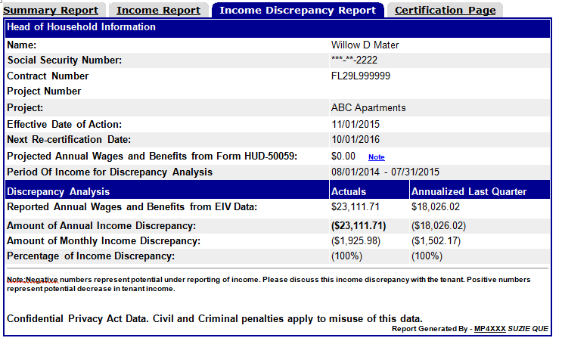
Income Discrepancy Report – Level 2
You have run the report, what now?
Important information:
50059 being analyzed
Income from 50059
Period of Income (POI)
Reported actual annual income
Reported annualized income from last quarter
Annual and monthly discrepancy

Slide 78
Income Discrepancy Report – level 2
What is the Period of Income (POI)?
The period of income (POI) will be a 12 month period beginning 15 months prior to the effective date of the last 50059 in TRACS
  The Income Discrepancy Report is analyzing the income that was listed on the last 50059 which may be almost a year old when this report is run
  This report is not analyzing the income for the recertification you are currently processing and running the Income Reports for

Slide 79
Reading and Interpreting – Level 2
POWER BOOST
  Why is this odd timeframe the the period of income (POI) used by EIV?
  The recertification period starts 120 days prior to the anniversary date, verifications at all certifications (MI, IC , IR, and AR) cannot be more than 120 days old; so the verifications obtained for the last recertification were obtained 1 to 4 months prior to the actual effective date lining it up about with the end of the POI timeframe EIV uses.

Slide 80
Income Discrepancy Report – Level 2
What is this report saying?
From 8/1/14-7/31/15 reported income was $23,111.71
The last quarter of income from 8/1/14-7/31/2015 annualized was $18,026.02
Last 50059 effective 11/1/2015 $0 was reported as income
Notes:
Answer on next slide

Slide 81
Income Discrepancy Report – Level 2
How do you interpret this information?
    There is possible unreported income that needs to be investigated to determine if there is a valid discrepancy because:
      In the 15 months prior to the last certification the tenant was receiving income
      At the time of the certification tenant reported $0 income
    Is this enough information to determine if this is a valid discrepancy?
    No
    What are some reasons why this discrepancy may have been generated?
    Job was reported, verified, and included on prior 50059s, but ended prior to the last certification, so this is a false positive
    Tenant was still working at that time of the last certification but did not report it, so this is unreported income

Slide 82
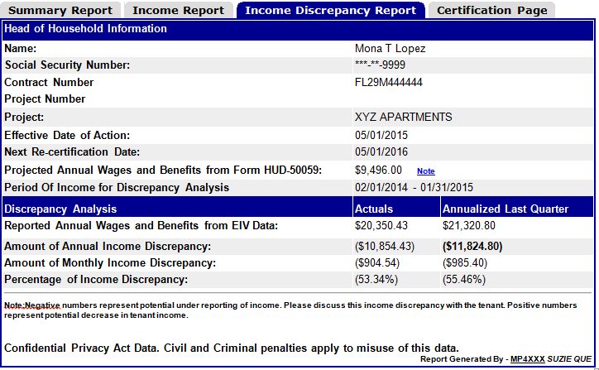
Income Discrepancy Report – Level 2
What is this report saying?
Notes:
Show tenant had reported annual wages and benefits of $20,350.53 and annualized last quester of $21,320.80. The annualized last quarter exceeds the $2400 discrepancy threshold. OA must investigate this to determine if the tenant should have reported a increase of $200 per month or more. If valid OA would obtain 3rd party verification and process a IR. If not a valid discrepancy OA will document the file with the results of the investigation.

Slide 83
Income Discrepancy Report – Level 3 and 4
If a tenant has a discrepancy listed on the Income Discrepancy Report:
Within 30 days from the date of the report review and resolve the discrepancy
  Determine if O/A error (calculation), tenant error (unreported/underreported), or false alarm
    Review the file, verifications, and 50059(s)
    Check for verification, miscalculation, or data entry errors
    If necessary, send notice to tenant and discuss the possible discrepancy with them
    If necessary, obtain 3rd party verification - required if unreported/underreported income
    Make any necessary corrections

Slide 84
Income Discrepancy Report – Level 5
    2. Notate the report with actions taken including explanation why a discrepancy may be a false positive
    3. Maintain Income Discrepancy Report with notations in the tenant file along with documentation of all follow up action taken to resolve possible unreported or underreported income including contact with tenant, verifications, corrected/additional 50059s, repayment agreement, additional file notes etc.

Slide 85
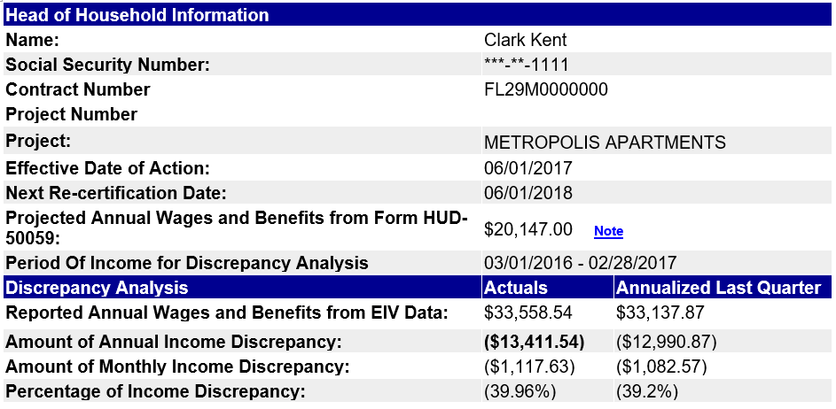
Income Discrepancy Report – Level 5
Are these notations acceptable?
Why or Why Not?
N/A period reviewed was prior to MI
Notes:
No because the tenant could have still been working when they moved in and not reported it

Slide 86
Level up - your understanding of how the income Discrepancy Report and Income Report work together
Income Discrepancy Report
Income Report
Unlocks a bigger picture

Slide 87
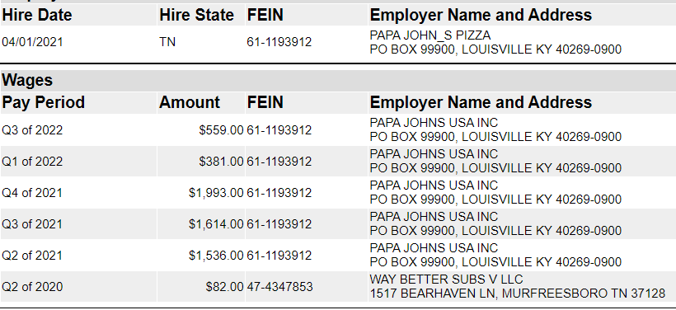
Connecting the Dots Between Income Report and Income Discrepancy Report
Scenario: This income report was run during 3/1/2023 AR processing and a discrepancy was generated
    The discrepancy report listed the last certification as 3/1/2022 with $0 income, annual discrepancy $5143, and last quarter annualized $7972. POI was 12/1/2020 - 11/30/2021.
    Looking at the income report above, can you determine why this discrepancy may have generated?
    EIV is showing a break in income from Papa Johns from some time in Q1 2022 with no wages reported in Q2 2022.

Slide 88
Connecting the Dots Between Income Report and Income Discrepancy Report
    What would you expect to see in the file?
    Verification at 3/1/2022 AR or some time in Q1 2022 showing date employment ended
    Verification for Papa Johns start date and wages earned
    IR with effective date corresponding to around the time the income started (EIV shows hire date of 4/1/2021 which is after the 2021 AR, and the increase was increase more than $200 a month).
    What should the note be on the discrepancy report?
    Notes should be something like: Tenant quit just prior to AR, verification obtained during last AR.
Bonus Question: What determines the effective date of the IR?
Notes:
Depends if the tenant complies with the reporting requirements or does not comply. If does comply for rent increase then need 30 day notice and the effective date of the increase will be the first of the month after the end of the 30 days period. For decrease will be the first of the month after loss of employment. If DOESN’T COMPLY then rent increase retroactive to the first month following the date of action. Decrease first rent period following completion of the recertification.

Slide 89
Existing Tenant Search
Common Issues found during the MOR regarding the Existing Tenant Search:
Report not being run or not run prior to MI
Report not being run for all household members including dependents
Report not being run for members added to the household after MI
Not notating follow up actions taken on the report or in the file

Slide 90
Summary Report
Common Issues found during the MOR regarding the Summary Report:
Not printing and maintaining the report
Not following up/resolving failed status
Not maintaining documentation of all follow up actions
Not reprinting when there is a change in household composition

Slide 91
Common Findings - Income Report
Top Findings:
Not run within 90 days after MI or IC 50059 submission
Not following up on possible unreported or underreported income (report run and placed in the file but not reviewed)
Not maintaining documentation of all follow up actions
Differences in net and gross SS amounts not followed up on
Not run at recertification

Slide 92
Common Findings - Income Discrepancy Report
Top Findings
Not printed when the Income Report was printed
Run when required (within 90 days after MI/IC submission and each recertification)
Not following up on the possible discrepancy (report run and placed in the file but not reviewed)
Not notating the report with notations sufficient to explain the reason for the discrepancy including if it was a false positive
Not maintaining documentation of all follow up actions

Slide 93

North Tampa Housing Development Corporation
Q & A

